Slide 1
SOC 105: Introduction to Sociology
Prof: Kristen Shorette
UG TA: Jessica
Grad TAs: Michael, Sienna, Sophia

Slide 2
Text Book
Essentials of Sociology: A Down-to-Earth Approach
By James Henslin
11th Edition
10th ed. will do, but not earlier
Loose-leaf version available with an online subscription
2 copies on reserve
Additional readings available on Blackboard

Slide 3
Clickers
Available at the bookstore
ResponseWare = free app for a smart phone
Need a license and to register your device to get credit
Must be ready to use Tuesday September 1st !

Slide 4
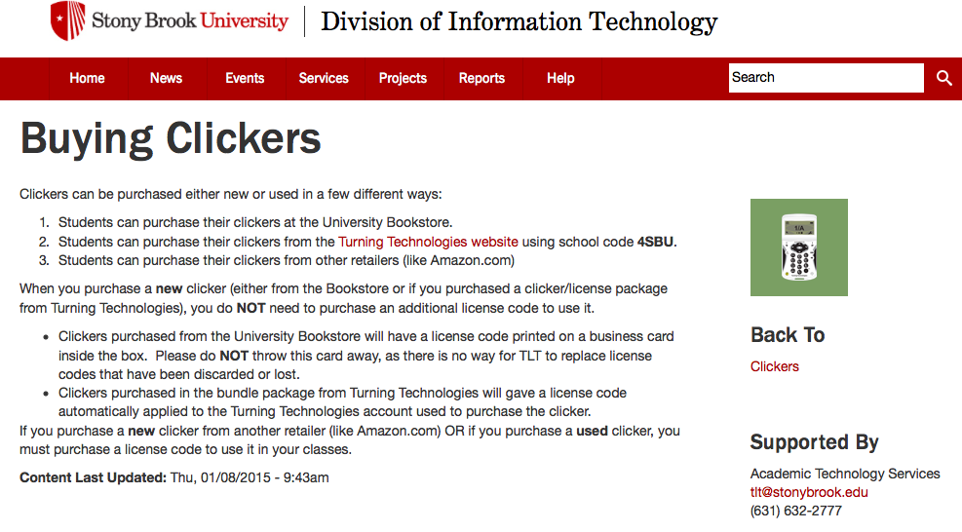

Slide 5
Participation
You must bring your clicker to class.
5-10 questions per class
10 freebees!
Use them wisely ☺
Having friends click in for you is considered academic dishonesty.
No exceptions!

Slide 6
Evaluation
In-class Activities (20%)
Reading Quizzes (10%)
Two Midterms (40%)
Thursday September, 24th
Thursday October 29th
Final Exam (30%)
December 14th, 5:30-8:00
All exams held in usual room Frey 102

Slide 7
Resources
Slides posted before class
Lectures recorded and posted after class
*review first for clarification
Blackboard and the Syllabus
TAs have office hours
Prof has office hours
DSS

Slide 8
Class Conduct
Computer and cell phone use
Respect for community
Punctuality

Slide 9
Academic Integrity
Representing another person’s work as your own is always wrong.
This includes clicking in for someone else.
See the Academic Judiciary website for your responsibilities and school policies.

Slide 10
To do well in this course
Come to class
Remember your clicker/phone
Use freebees wisely
Keep up with the readings
Plan ahead for exams
Reach out to TAs and the Professor
Make use of SBU supports

